Slide 1
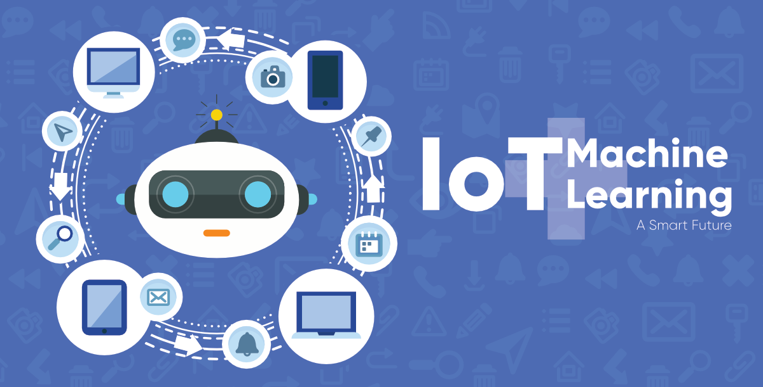
Machine learning fusion with iot By – Devendra Chaturvedi

Slide 2
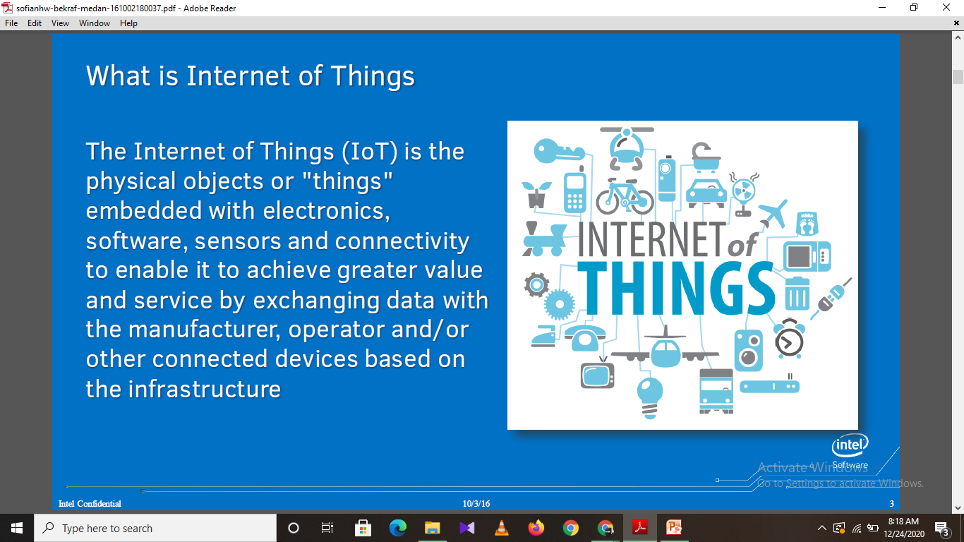

Slide 3
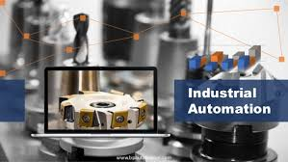
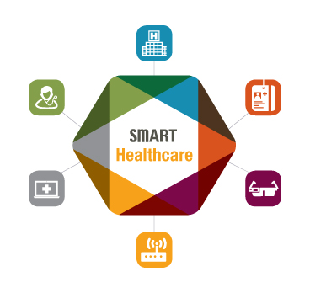
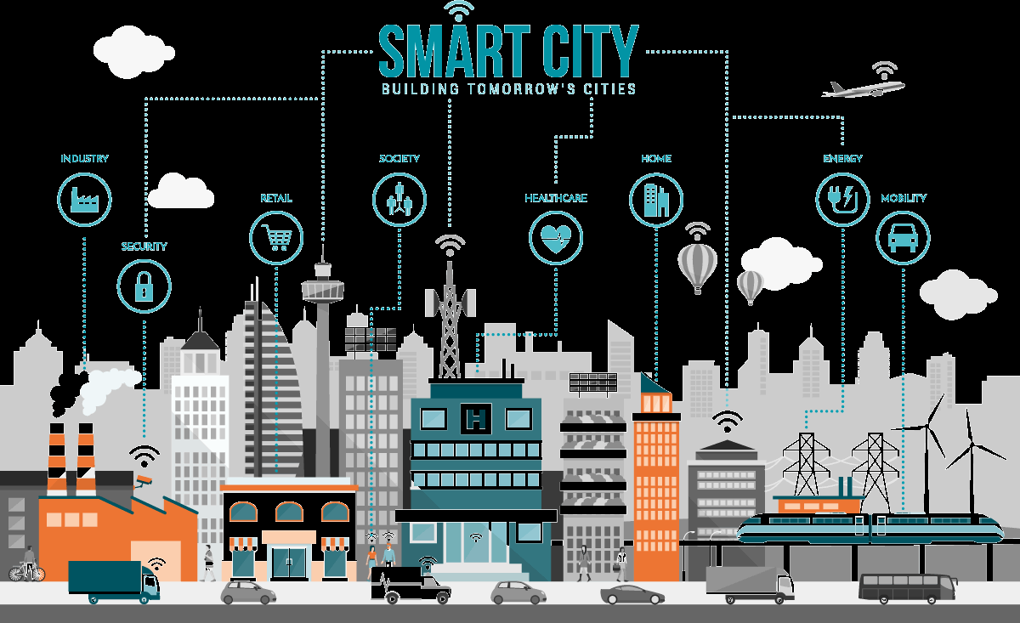
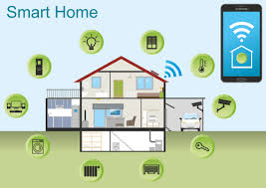
Typical Views of the Internet of Things

Slide 4
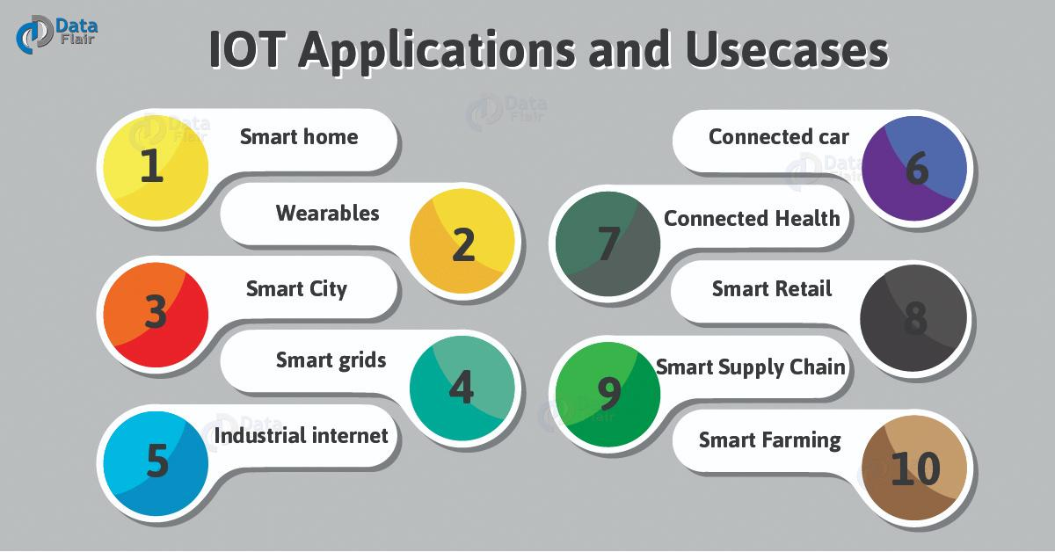

Slide 5
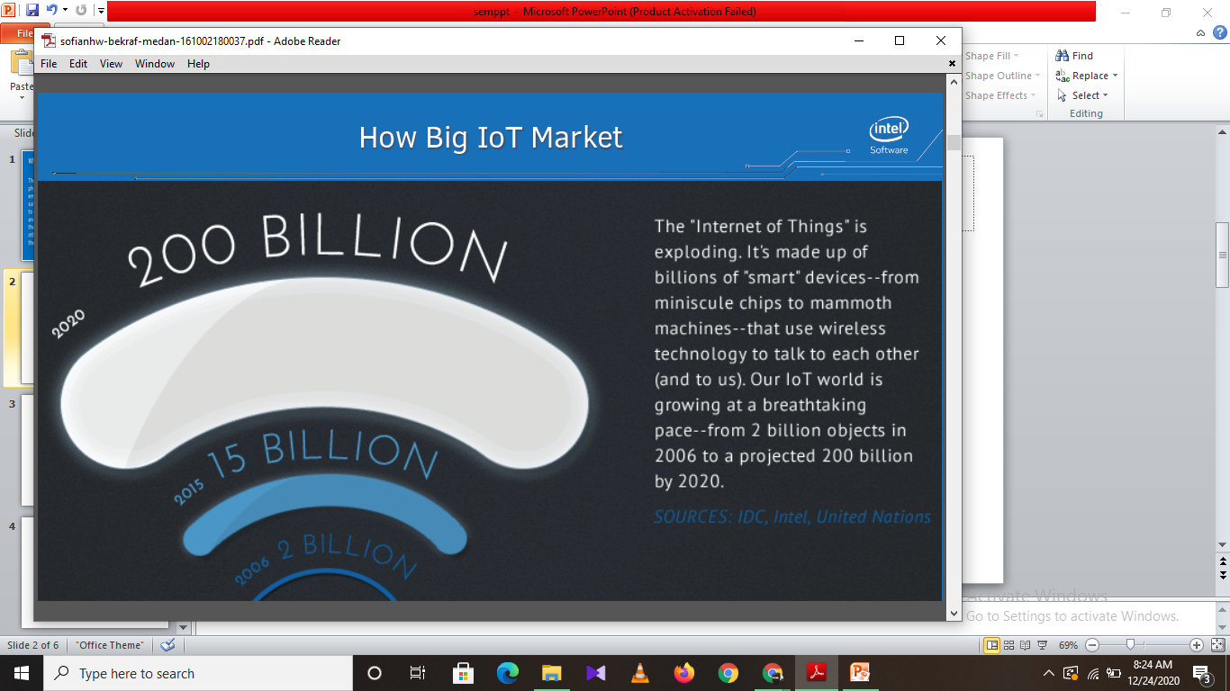
How Big IOT Market

Slide 6
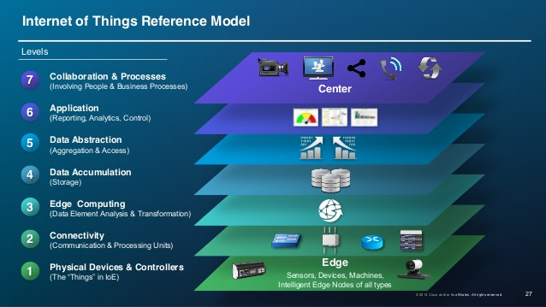
IOT ARCHITECT

Slide 7
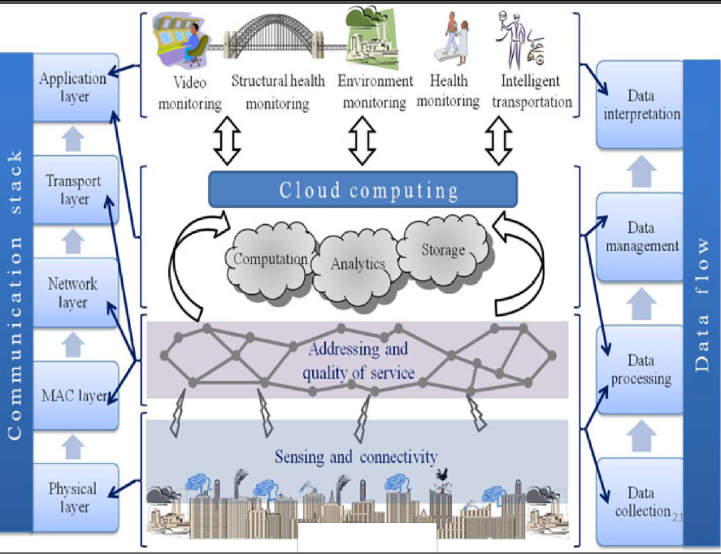

Slide 8
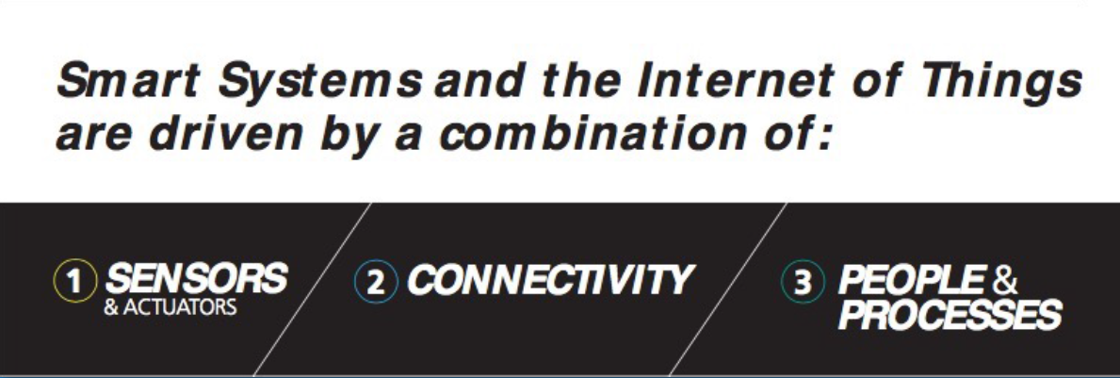
HOW TO MAKE IOT

Slide 9
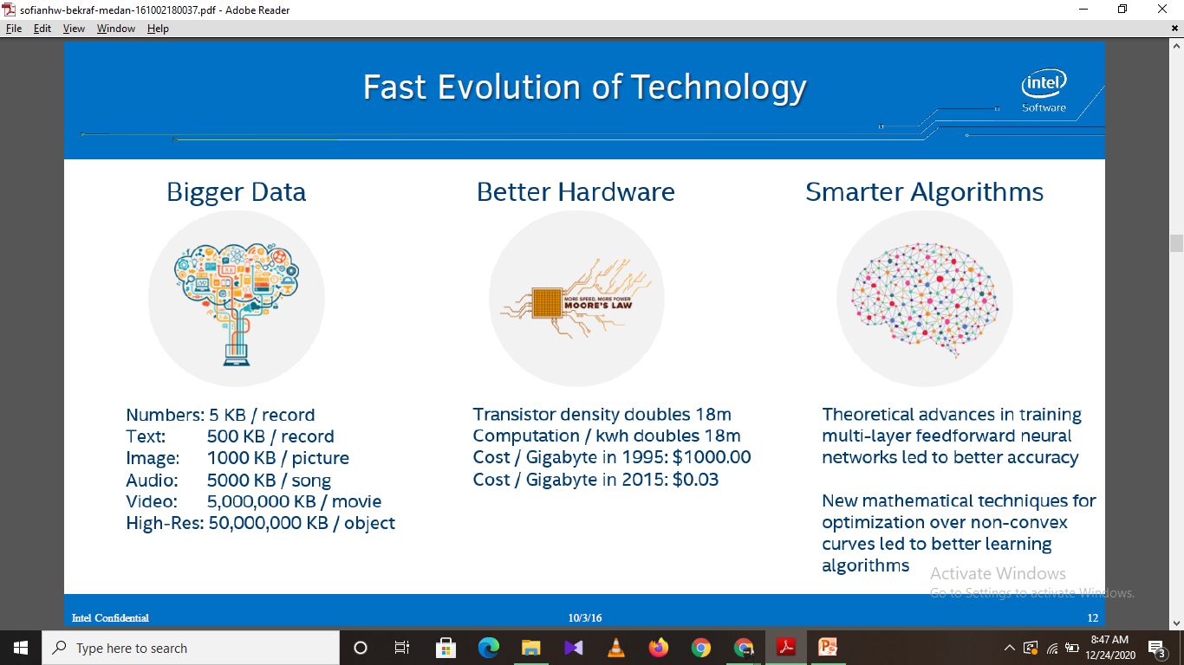
FAST EVOLUTION OF TECHNOLOGY

Slide 10
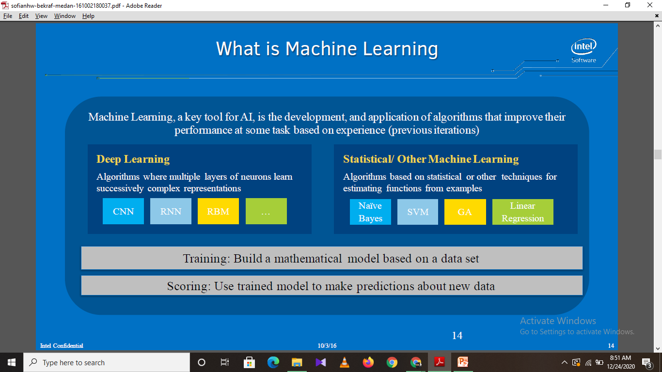
WHAT IS MACHINE LEARNING

Slide 11
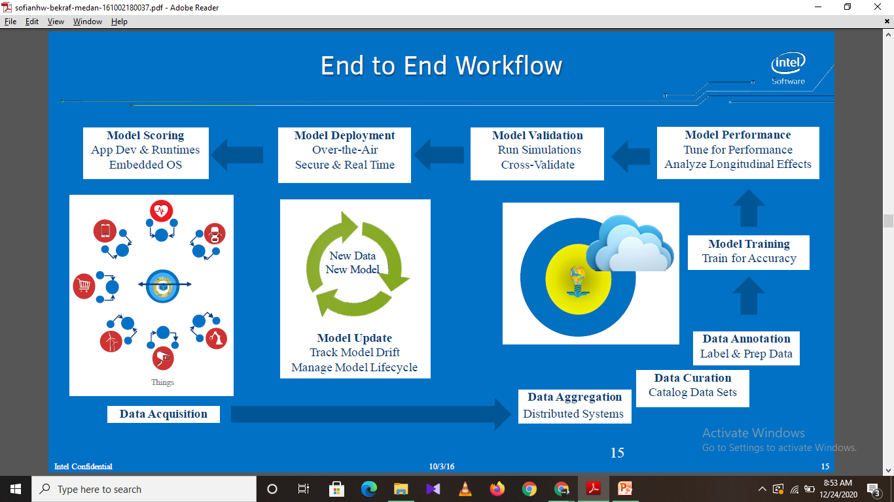
END TO END WORK FLOW

Slide 12
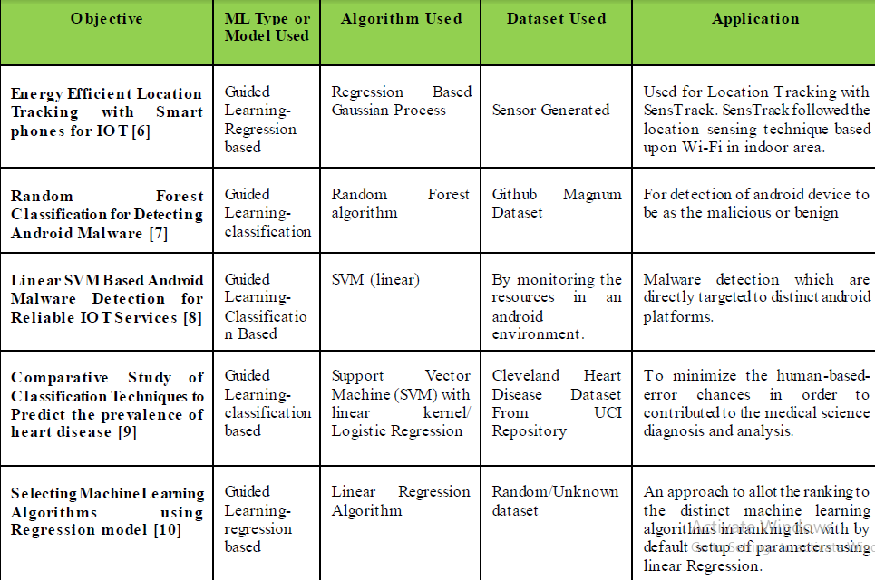
ANALYSIS OF DIFFERENT TYPES OF MACHINE LEARNING ALGORITHMS APPLICATIONS WITH IOT

Slide 13
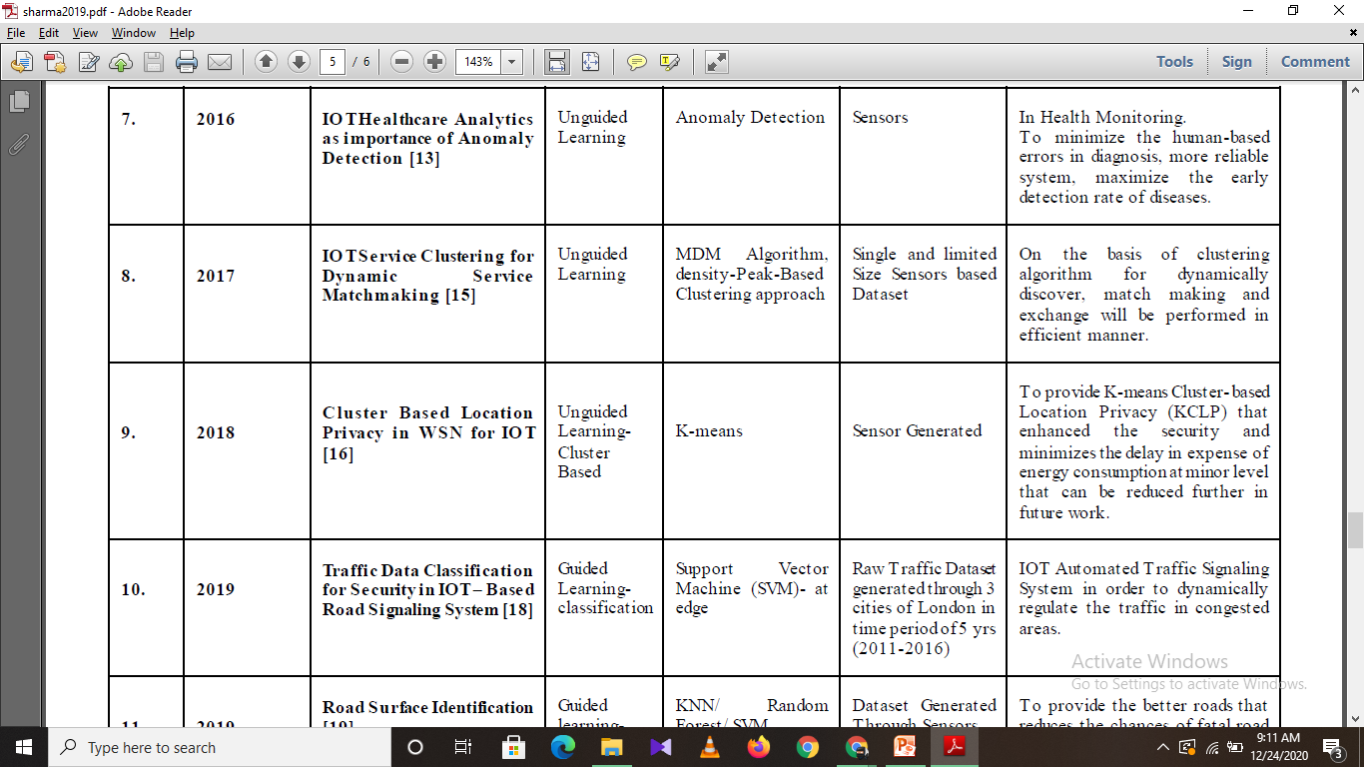

Slide 14
CONCLUSION
Machine Learning has an explosive potential to be the key technology for the pervasive environment of IOT. The recent radiations of success of Machine Learning along with IOT prove their fusion as the wonderful source in the field of Data science. In this cutting-edge of artifacts based intelligence of upcoming technologies, the new inventions are reaching at the pinnacle with the perspective of establishing inter-connections in between the physical world objects that provides advanced, smart and reliable life to living being.

Slide 15
REFERENCES
[1] ht tps://www.seagate.com/in/en/our-story/data-age-2025/
[2] Laizhong Cui, Shu Yang and et al. “A survey on application of machine learning for Internet of Things”. International Journal of Machine Learning and Cybernetics, August 2018, Vol. 9, Issue 8, pp 1399–1417.
[3] Luigi At zori, Antonio Iera, Giacomo Morabito. “The Internet of Things: A survey”. Computer Networks.

